Slide 1
CS 211 Computer Architecture Lecture 6: Computer System: Basics
Ravi Mittal
ravi.mittal@iitgoa.ac.in
Indian Institute of Technology, Goa

Slide 2
Today’s Thought
Dirty your hands .. If you really want to learn anything..
You can’t learn driving just by reading manuals..
You can’t learn Programming, just by reading books
You can’t even realize God… by reading spiritual Granths
You need to practice … dirty your hands..
Don’t say “my laptop is not working”, “tool is not working”…. Learn to use it .. Fix it .. Make effort..

Slide 3
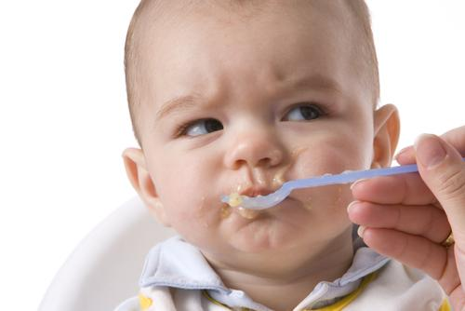
"Spoon feeding in the long-run only teaches us the shape of the spoon." E.M. Forster

Slide 4
Reading
Patt and Patel book, Chapter 4
Lecture slides of Prof Onur Mutlu, Course 18-447, Computer Architecture, Carnegie Mellon University
Computer Systems Book: Bryant and O’Hallaron, Chapter 2

Slide 5
In today’s class, we will study..
What is in a computer?
Memory
Addressability – Address Space
Word-addressable Memory
Byte-addressable Memory
Big Endian vs Little Endian
How to interconnect different parts of a computer system?
Trivia – Digital Transformation

Slide 6
What is in a Computer?

Slide 7
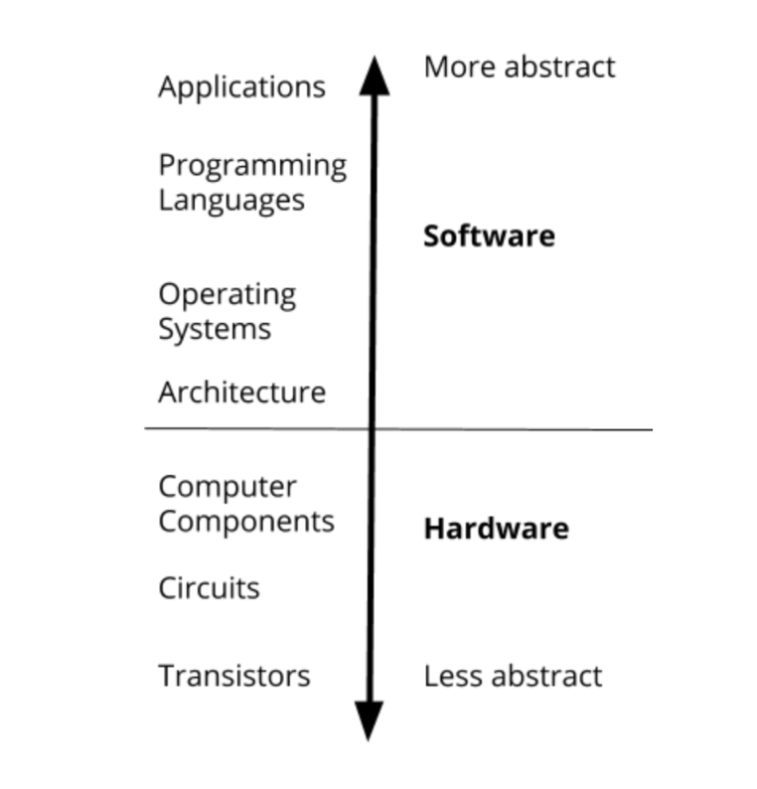
What is in a computer?

Slide 8
To get work done by computer
We need
Computer
Data
Program: A set of instructions
Instruction: The smallest piece of work in computer

Slide 9
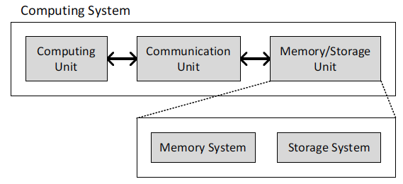
What is in a Computer?
Three key components
Computation
Communication
Storage / memory
From Prof Onur Mutlu’s presentation

Slide 10
What is in a Computer?
Processing
Memory
(program
and data)
I/O
control
(sequencing)
datapath
From Prof Onur Mutlu’s presentation

Slide 11
Datapath
The collection of state elements, computation elements, and interconnections that together provide a conduit for the flow and transformation of data in the processor during execution
Element that processes data and addresses
Register file, ALU, Buses, Memories, Buffers, Adders etc

Slide 12
Memory - basics

Slide 13
Memory
The memory stores
Data
Programs
Memory of two primary types
Volatile Memory
Memory that looses stored information when there is no electric power; Power is required to retain information
Example: Random Access Memory (RAM)
SRAM (Static RAM), DRAM (Dynamic RAM)
Non-volatile Memory
Memory that retains information when there is no electric power
Read Only Memory (ROM), Flash Memory, Optance Memory (Phase shift), Hard Disk, Magnetic Tape, Optical Disk, Floppy Disk
Notes:
x86-64:
* Memory organization:
- Address space: up to 2^48.
- Addressability: up to 48 bits. The actual length of the address is 64 bits, but bits 48 to 63 are sign extended.

Slide 14
Memory
Access time: SRAM < DRAM < FLASH < Hard Disk < Magnetic Tape
Storage Capacity: Magnetic Tape > Hard Disk > Flash > DRAM > SRAM
Cost: SRAM > DRAM > Flash > Hard Disk
We use the fastest memory (SRAM) closest to the processor – as it is very fast (less response time)
Use as Cache memory

Slide 15
The Memory Hierarchy (will study later)
Processor
move what you use here
fast
small
With good locality of reference, memory appears as fast as
and as large as
faster per byte
cheaper per byte
backup
everything
here
big but slow
From Prof Onur Mutlu’s presentation

Slide 16
Memory
The memory
Conceptually, envision it as a very large array of bytes
Bytes are grouped into words
Machine Words
Any given computer has a “Word Size”
Word size" refers to the number of bits processed by a computer's CPU in one go
Nominal size of integer-valued data and of address (?)
Typically each register stores one word
Typical word size: 8, 16, 32, 64 bits
Intel’s 64-bit processor doesn’t address 2⁶⁴ locations
Until recently, most machines used 32 bits (4 bytes) as word size
Now it is 64-bit word size in modern machines

Slide 17
Addressability - Address Space
How the bits are accessed determines the addressability
Byte- Addressable: 8-bit are addressable at a given address
Word-addressable
One word is addressable at a given an address
RISC-V is byte addressable
The total number of addresses is the address space
In RISC-V, the address space is 2³²
32-bit addresses
In x86-64, the address space is (up to) 2⁴⁸
48-bit addresses
Notes:
x86-64:
* Memory organization:
- Address space: up to 2^48.
- Addressability: up to 48 bits. The actual length of the address is 64 bits, but bits 48 to 63 are sign extended.

Slide 18
Word-addressable Memory
00•••0
00•••1
• • •
Word 0
Word 1
Conceptually, memory is envisioned as a very large array of bytes
Each data word has a unique address
Consider 32-bit data word
One word is read at a time. Most operations are on a word.
For byte operations - one word is read and then byte is extracted by some operation
Most programmer’s want to manipulate single byte
Word addressable memory is not popular

Slide 19
Byte-Addressable Memory
00•••0
00•••4
• • •
Word 0
Word 1
Each byte has a unique address
RISC-V is byte-addressable
We still have notion of word but address uses byte address
Diagram shows 4-byte word
Close to reality – the way programmers want to manipulate data
If you are operating on bytes, it’s good to have byte – oriented memory
Within a word – which is byte 0, byte 1, byte 2 and byte 3 ?

Slide 20
Byte-Addressable Memory – different word sizes
32-bit
Words
64-bit
Words
Bytes
Addr.
Addresses Specify Byte Locations
Address of first byte in word
Addresses of successive words differ by 4 (32-bit) or 8 (64-bit)
For 32-bit words
Address of the first word: 0000
Address of the second word: 0004
And so on
For 64-bit words
Address of the first word: 0000
Address of the second word: 0008
And so on
0000
Addr
=
??
0001
0000
0002
Addr
=
??
0003
0000
0004
Addr
=
??
0005
0004
0006
0007
0008
Addr
=
??
0009
0008
0010
Addr
=
??
0011
0008
0012
Addr
=
??
0013
0012
0014
0015

Slide 21

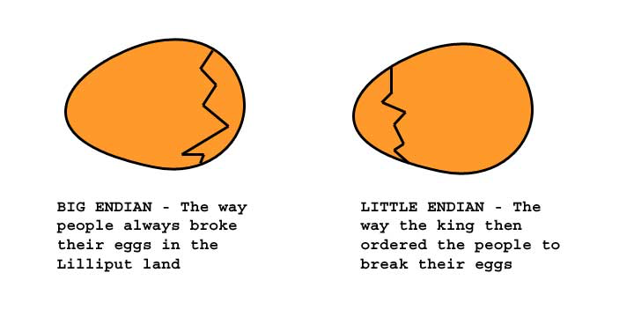
Big Endian vs Little Endian
Jonathan Swift’s Gulliver’s Travels
Little Endians broke their eggs on the little end of the egg
Big Endians broke their eggs on the big end of the egg
From Prof Onur Mutlu’s presentation

Slide 22
Byte Ordering Example
Big Endian
Least significant byte has highest address
Little Endian
Least significant byte has lowest address
Example
Variable x has 4-byte representation 0x01234567
Address given by &x is 0x100
Lower byte Address
Higher byte Address
Big Endian
0x100
0x101
0x102
0x103
01
01
23
23
45
45
67
67
Little Endian
0x100
0x101
0x102
0x103
67
67
45
45
23
23
01
01

Slide 23
Big Endian
Vs
Little Endian
Does this really matter?
Answer: No, it is a convention
Qualified answer: No, except when one big-endian system and one little-endian system have to share data
From Prof Onur Mutlu’s presentation
Notes:
It is a convention, same as German is written from left to right, and Persian is written from right to left.

Slide 24
How to Interconnect different components of a Computer System?

Slide 25
Interconnecting parts of a computer
We have studied many parts of a computer
CPU, Memory, Disk, Peripherals, etc
How to connect them to each other ?
Simple Solution: Use a set of shared communication links (wires) to interconnect various subsystems
Call this arrangement: Bus
CPU
Keyboard
Display
Bus
RAM
Hard
Disk
CD-ROM

Slide 26
Bus
data lines
address lines
control lines
Bus Lines (Parallel)
Data lines
Passes data back and forth
Number of lines represent width
Address Lines
Designates location of source or destination
Width of address bus specifies maximum memory capacity
Control Lines
Carry control signals
Memory Read or Write, I/O Read or Write, Transfer ACK
Bus request, Bus grant, Interrupt request etc

Slide 27
Buses
CPU chip
Register file
ALU
System bus
Memory bus
Main
memory
Bus interface
I/O
bridge
PCI Bus
I/O bus
Expansion slots for
other devices such
as network adapters.
USB
controller
Graphics
adapter
Disk
controller
Mouse
Keyboard
Monitor
Disk
Adapted from Computer Systems Book: Bryant and O’Hallaron

Slide 28
Trivia

Slide 29


Big Data, this is just the Beginning
The number of stars in the universe
10²³
You are here
Sensors & Devices
World's Data (Bytes)
Social Media
VoIP
Enterprise Data
2010
2015
Notes:
“The Internet of [Things] could raise the level of U.S. gross domestic product by 2%-5% by 2025.
This gain… if realized, would boost the annual U.S. GDP growth rate by 0.2%-0.4% points over this period, bringing growth closer to 3% per year.”

Slide 30
Digital Transformation of Business
Everything is becoming smarter
Computer with cooling functionality (Fridge), Computer with washing capability (Washing machine)
Digital Technologies (Computer) help devices to become
Flexible
User friendly
Programmable
Adaptive
Enhance features
Interconnected
…smarter
Businesses that are not adapting digital technologies are dying …

Slide 31
What is common among these companies
Eastman Kodak Company
Camera, Photography Equipment, Chemicals
Polaroid Corporation
Photography
Blockbuster Inc
Video Rental company
Border’s Group
Bookstore business

Slide 32
What is common among these companies
Eastman Kodak Company
Camera, Photography Equipment, Chemicals
Polaroid Corporation
Photography
Blockbuster Inc
Video Rental company
Border’s Group
Bookstore business
All these companies failed to adopt to digital technologies

Slide 33
Trivia
Which of the following companies make the largest number of cameras and camera parts
Nikon
Cannon
Fujifilm
Olympus
Sony

Slide 34
Trivia
Which of the following companies make the largest number of cameras and camera parts
Nikon
Cannon
Fujifilm
Olympus
Sony
Sony supplies camera parts to almost all smart mobile phone manufacturer
Mobile phone cameras has almost killed traditional camera business

Slide 35
Next Class: Von Neumann Architecture

Slide 36
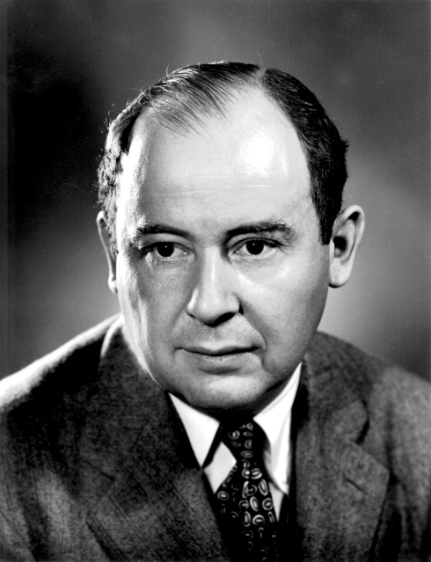
Von Neumann Model
John von Neumann proposed a fundamental model in 1946
It consists of 5 parts
Memory
Processing unit
Input
Output
Control unit
Burks, Goldstein, von Neumann,
“Preliminary discussion of the logical design
of an electronic computing instrument,” 1946.
From Prof Onur Mutlu’s presentation

Slide 37
The Von Neumann Model
MEMORY
Mem Addr Reg
Mem Data Reg
INPUT
Keyboard,
Mouse,
Disk…
PROCESSING UNIT
OUTPUT
Monitor,
Printer,
Disk…
ALU
TEMP
CONTROL UNIT
PC or IP
Inst Register
From Prof Onur Mutlu’s presentation

Slide 38
The Von Neumann Model
MEMORY
Mem Addr Reg
Mem Data Reg
INPUT
Keyboard,
Mouse,
Disk…
PROCESSING UNIT
OUTPUT
Monitor,
Printer,
Disk…
ALU
TEMP
CONTROL UNIT
PC or IP
Inst Register
From Prof Onur Mutlu’s presentation

Slide 39
Accessing Memory: MAR and MDR
There are two ways of accessing memory
Reading or loading
Writing or storing
Two registers are necessary to access memory
Memory Address Register (MAR)
Memory Data Register (MDR)
To read
Step 1: Load the MAR with the address
Step 2: Data is placed in MDR
To write
Step 1: Load the MAR with the address and the MDR with the data
Step 2: Activate Write Enable signal

Slide 40
Registers

Slide 41
Registers
Registers are very important part of Processor
Memory is big but slow
Registers
Operate at processor speed (a few clock cycles)
Ensure fast access to operands
Typically one register contains one word
Register set or file
A set of registers
Register size = Word length = 32 bits (in MIPS)

Slide 42
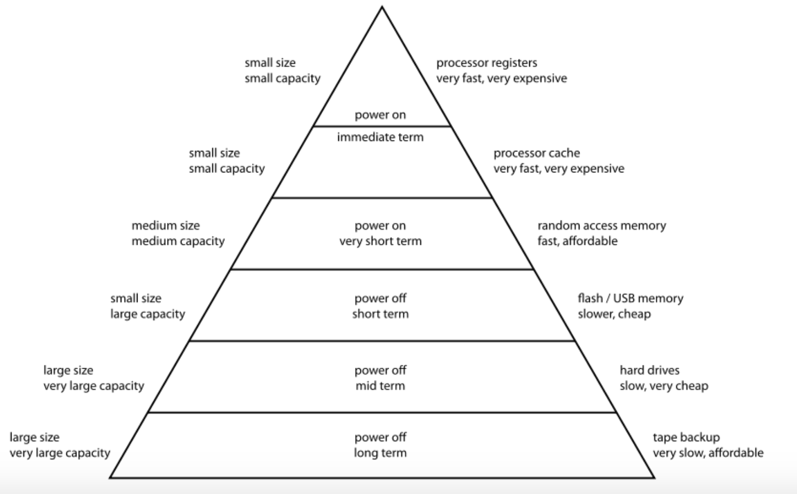
Register Access time: approx. 0.1 ns
A few processor cycles
Cache Access time: 1-2 ns
DRAM Access time : 50-150 ns
SSD Access time : 40-100 micro second
Hard Disk Access time : 10-15 milli second
Tape Access time : 50-60 seconds

Slide 43
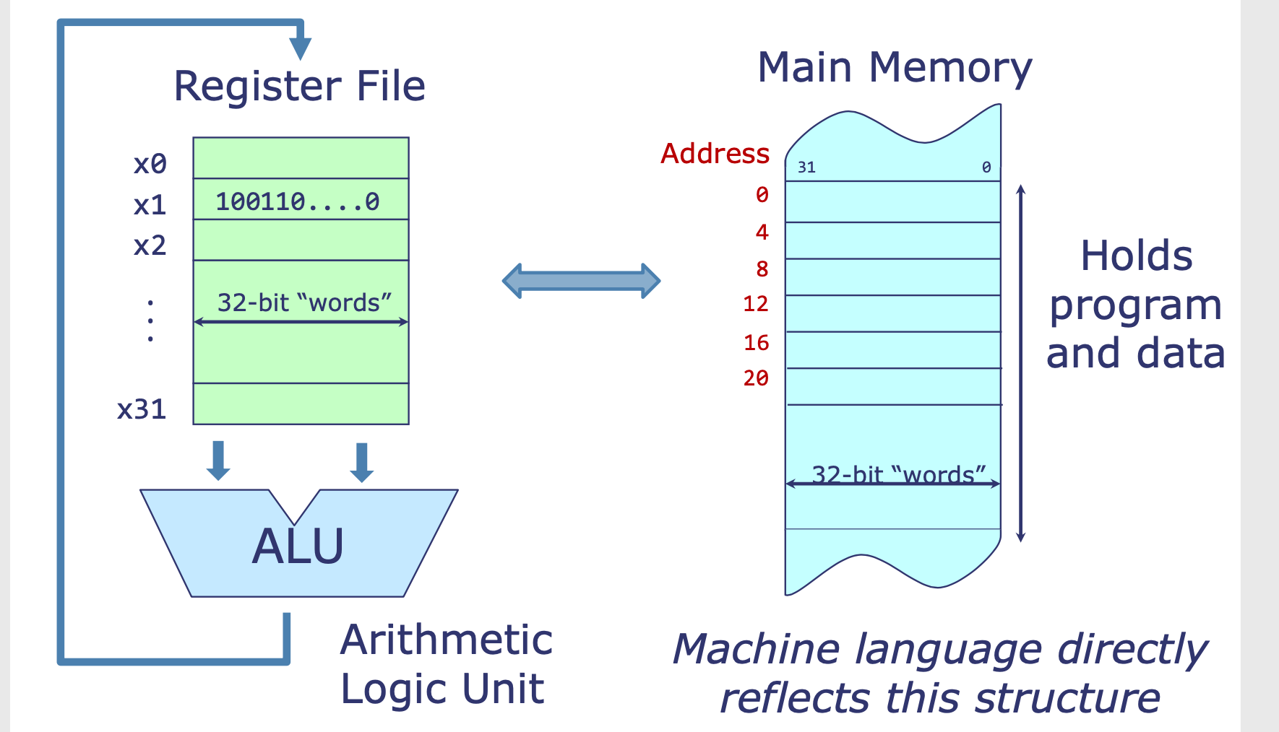
Register File Interactions
Notes:
Memory is slow
Registers are fast – work at processor speed
So, Contents (Instruction and data) are brought from MM to Registers.
Also, contents (data) is stored from Registers to MM
Memory contains both program and data

